Slide 1
Chapter 2: Data Communiction and Networking

Slide 2
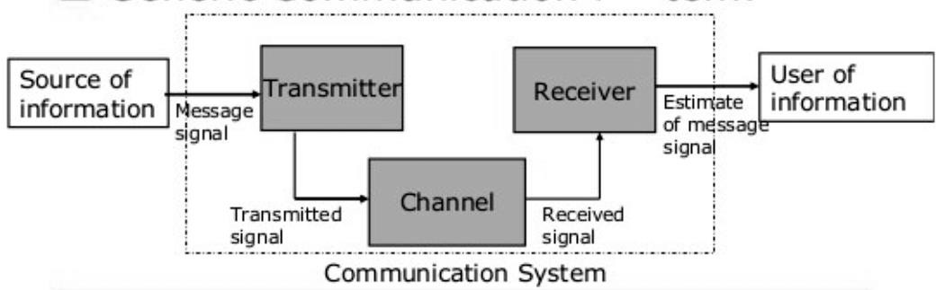
Chapter 2: Data Communiction and Networking
Introduction
A network is an interconnection of two or more computers or networking devices
with the help of
transmission media and protocols.
Computer networks bring communication (information exchange) that is faster, more reliable, cheaper, and more secure.
A communication system has five major components:

Slide 3
Message
The message is the data or information to be communicated, and it can be in the form of text, numbers, pictures, audio, or video.
Sender/Source
The sender device sends the message to the receiver, and it can be a computer, workstation, or any networking device.

Slide 4
Receiver
The receiver device receives the messages from the medium, and it can be a computer, workstation, or any networking device.
Transmission Medium
The transmission medium is the physical connection through which a message can travel from the sender to the receiver and vice versa.
The medium can be wired or wireless.
Protocols
A protocol is a set of common rules that manages the data communication. Without a protocol, two devices can be connected but not be able to communicate.

Slide 5
Advantages of Computer Networking
Sharing Data and Resources
Enables multiple users to access files, printers, and storage devices across the network, reducing redundancy and costs.
Faster and Cheaper Communication
Instant messaging, email, and VoIP replace traditional methods, saving time and expenses (e.g., reduced travel for meetings).
Centralized Control
Simplifies management of software updates, security policies, and user
permissions from a single server.
Backup and Recovery
Centralized data storage allows automated backups, minimizing data loss risks.
Remote Access
Supports remote work by allowing employees to access network resources from anywhere (e.g., VPNs, cloud services).

Slide 6
Disadvantages of Computer Networking
Privacy Issues
Unauthorized access to sensitive data (e.g., via weak passwords or insider threats) can lead to breaches.
Complex Setup
Requires expertise to configure hardware (routers, switches) and software (firewalls, protocols), which may be costly for small organizations.
Hacking Risks
Networks are vulnerable to cyberattacks like DDoS, phishing, or ransomware
without robust security measures.
Dependence on Technical Personnel
Ongoing maintenance (troubleshooting, updates) demands skilled IT staff, adding operational costs.
Virus Spread
Malware can propagate rapidly across connected devices if antivirus protection is inadequate.

Slide 7
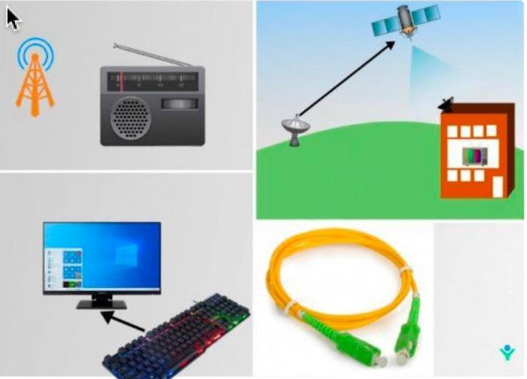
Modes of communication
Data communication can be classified into three types on the basis of direction of communication flow:
a) Simplex
Simplex mode is a transmission mode in which information is sent in one direction only, also known as unidirectional/one way direction.
A B
Fig: simplex
Fig: Simplex communication:

Slide 8
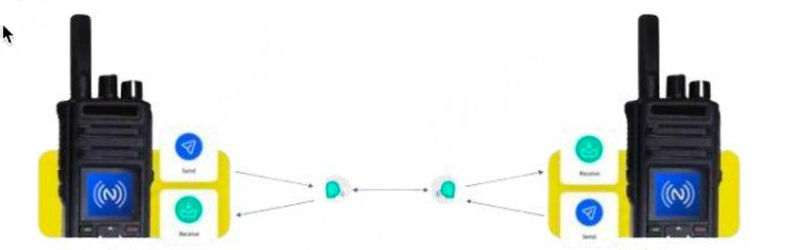
b) Half-duplex
Half-duplex mode is a communication mode where two devices can communicate with each other, but not simultaneously.
A
B
A
B
Fig: Half Duplex
Device 1
Device 2
One Direction at a time

Slide 9

c ) Full duplex
Full-duplex communication is a method that allows data to be sent and received simultaneously.
It's similar to a two-way road, where traffic can flow in both directions at the same time.
A B
Fig: Full Duplex
Both Direction at a time
Device 1
Device 2

Slide 10
Types of computer network
1 ) On the basis of Geographical Area
On the basis of geographical area, computer networks are classified into following three categories:

Slide 11
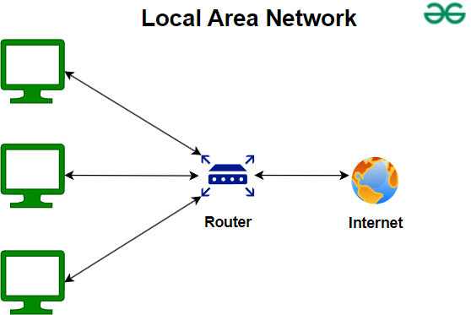
a ) Local Area Network (LAN)
A local area network (LAN) is privately owned small sized network which spans only in small geographical area such as within a room, office, building or up to few kilometers (2 or 3 kilometers).
For example, network used in our college or office. It is simpler, cheaper and highly secured
network .

Slide 12
Advantages of LAN
It is cheaper to establish.
Data transmission is faster than MAN and WAN.
It has higher security to resources of the network
It is easier to establish, managees of the network and operate
Disadvantages of LAN
It is limited only to a small area.
It can connect less number of computers comparatively.
Cannot be used as distributed network.

Slide 13
b ) Metropolitan Area Network (MAN)
A metropolitan area network (MAN) is a computer network that connects computers within a metropolitan area, which could be a single large city, multiple cities and towns, or any given large area with multiple buildings. A MAN is larger than a local area network (LAN) but smaller than a wide area network (WAN). Network used called Intranet.
For example, cable TV network, Internet Service Provider (ISP) in a city, etc.

Slide 14
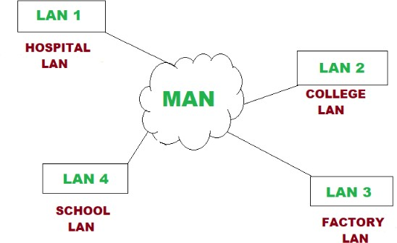
Fig: Metropolitan Area Network(MAN)

Slide 15
Advantages of MAN
It covers larger geographical area than LAN.
It can connect large number of computer than LAN.
We can use guided as well as unguided type of transmission media.
Disadvantages of MAN
It is expensive to set up then LAN.
Transmission speed slower compared to LAN.
It is complex to establish, manage and provides security.

Slide 16
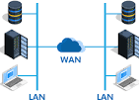
c ) Wide Area Network (WAN)
A wide-area network (WAN) is the technology that connects your offices, data centers, cloud applications, and cloud storage together. It is called a wide-area network because it spans beyond a single building or large campus to include multiple locations spread across a specific geographic area, or even the world.
For example, internet, networking of a bank, etc.
Fig: Wide Area Network (WAN)

Slide 17
Advantage of WAN
It covers larger geographical area than LAN and MAN.
It can connect large number of computer compared to LAN and MAN.
Using WAN communication can be done over a large distance.
Disadvantage of WAN
It is expensive to establish, manage and operate.
It is the slowest type of network compared to that of LAN and MAN.
Highly qualified manpower are required to establish and run these type of network.

Slide 18
Differences Between LAN, MAN, and WAN
Basis | LAN | MAN | WAN
Full-Form | LAN stands for local area network. | MAN stands for metropolitan area network. | WAN stands for wide area network.
Geographic Span | Operates in small areas such as the same building or campus. | Operates in large areas such as a city. | Operates in larger areas such as country or continent.
Ownership | LAN’s ownership is private. | MAN’s ownership can be private or public. | While WAN also might not be owned by one organization.
Transmission Speed | The transmission speed of a LAN is high. | While the transmission speed of a MAN is average. | Whereas the transmission speed of a WAN is low.
Propagation delay | The propagation delay is short in a LAN. | There is a moderate propagation delay in a MAN. | Whereas, there is a long propagation delay in a WAN.
Congestion | There is less congestion in LAN. | While there is more congestion in MAN. | Whereas there is more congestion than MAN in WAN.
Design & Maintenance | LAN’s design and maintenance are easy. | While MAN’s design and maintenance are difficult than LAN. | Whereas WAN’s design and maintenance are also difficult than LAN as well MAN.

Slide 19
Differentiate between Internet Intranet and Extranet
Point of difference | Internet | Intranet | Extranet
Accessibility of network | Public | Private | Private
Coverage | All over the world. | Restricted area upto an organization. | Restricted area upto an organization and some of its stakeholders or so.
Accessibility of content | It is accessible to everyone connected. | It is accessible only to the members of organization. | Accessible only to the members of organization and external members with logins.
No. of computers connected | It is largest in number of connected devices. | The minimal number of devices are connected. | The connected devices are more comparable with Intranet.
Security | It is dependent on the user of the device connected to network. | It is enforced via firewall. | It is enforced via firewall that separates internet and extranet.
Maintenance | It is maintained by ISP. | It is maintained by CIO. HR or communication department of an organization. | It is maintained by CIO. HR or communication department of an organization.
Economical | It is more economical to use. | It is less economical. | It is also less economical.
Example | What we are normally using is internet. | WIPRO using internal network for its business operations. | DELL and Intel using network for its business operations.

Slide 20
2 ) On the basis of Network Architecture
Network architecture refers to the various services provided by the network and it also deals with how data is transmitted from one computer to others. On the basis of network architecture, computer networks are classified into two types:
I ) Client Server Network Architecture
A client-server network is a type of internet network that uses a central computer, called the server, to manage resources and control user access. The server provides services or functions to one or more clients, which request them. Clients are the devices that request services and use the services provided by the servers.

Slide 21
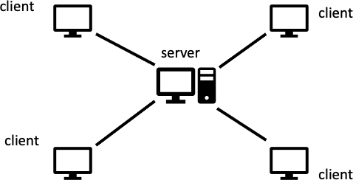
Fig: Client Server Network Architecture

Slide 22
Advantages of Client Server Network Architecture
Centralized administration is possible through this network.
High security can be provided by suing appropriate server.
It is appropriate for large organization.
Data recovery and backup process is easier.
Disadvantages Client Server Network Architecture
If server fails whole network is affected.
It is expensive due to use of dedicated server.
It is complex to establish and manage.
Experienced administrator is required to operate.

Slide 23
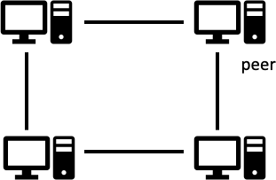
II) Peer to Peer Network Architecture
In this architecture, each node/workstation has same capabilities and responsibilities in a network. Here each node act like a server and client.
Fig: Peer to Peer Network Architecture

Slide 24
Advantages of Peer to Peer Network Architecture
It is simple cheap and easier to set up.
Since there is no dedicated server, user can manage their own server.
Failure of a computer in a network doesn't effect the other computer in a network.
No data collision.
Disadvantages of Peer to Peer Network Architecture
Data security is very poor in this type of architecture.
Data recovery and backup is difficult.
It is not appropriate for large scale organization.
Network administration is difficult it without dedicated Server.

Slide 25
Transmission Media
Transmission media refers to the physical connection through which data are transmitted between sender and receiver devices. They are classified as follows:
Guided / bounded / wired media
Unguided media / Unbounded / wireless media 1 ) Guided Media
Guided media is a physical link between devices that can send data through wires. For example, twisted pair cable, co- axial cable, optical fiber, etc.

Slide 26
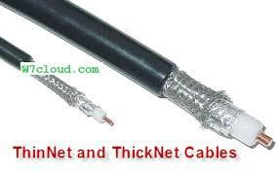
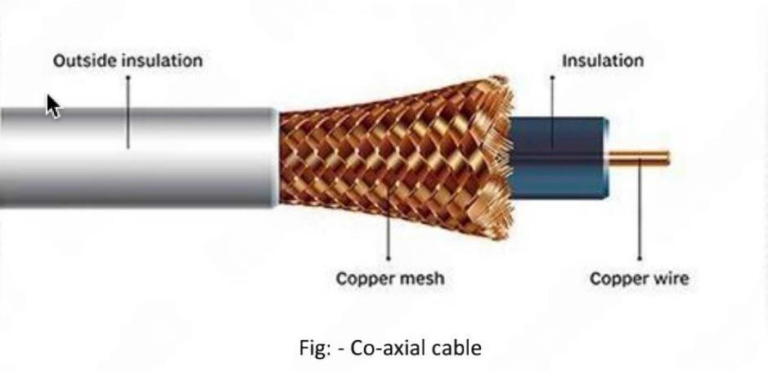
i. Co - axial cable:
This cable consists of a copper wire conductor which is surrounded by an insulator over which there is sleeve of copper is surrounded which is then covered by protective plastic.
It is of two types:
Thicknet Co - axial cable
Thinnet Co - axial cable

Slide 27
Advantages of Co - axial cable :
It is faster and reliable than twisted pair cable.
It can carry signal u p to 500 meter and bandwidth up to 100 Mbps.
It supports multiple channels in a medium and less effective by electromagnetic interference.
Disadvantages of Co - axial cable :
It is not appropriate for relatively larger distance.
The data within co-axial cable can easily be tapped.
It is expensive than twisted pair cable.

Slide 28
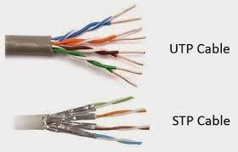
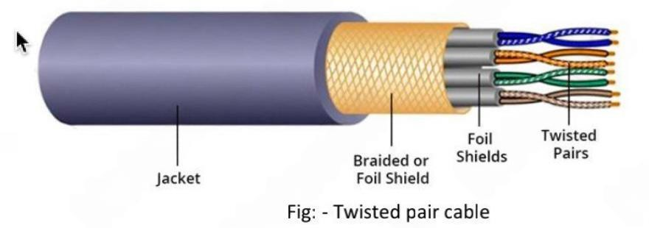
Twisted pair cable/LAN CABLE
Twisted par cable is made up of copper wires to each other and finally surrounded by insulating jacket. One wire of the pair is used for receiving signal and other wire is used for transmitting data. It is used for both analog and digital transmission. It is available in different categories i.e. CAT 1, CAT 2, ..., CAT 6, CAT 7, etc.
It is of two types:
UTP (Unshielded Twisted Pair)
STP (Shielded Twisted Pair)/ethernet

Slide 29
Advantages of Twisted pair cable
It is cheaper than other cables.
It is light and thin. So, it is flexible for LAN.
It has higher data transfer rate up to 1 Gbps.
Disadvantage of Twisted pair cable
It is not possible to transmit data for a long distance (up to 200m).
It can be affected by electrical and magnetic field.
It is slower type of transmission media compared to other cables.

Slide 30
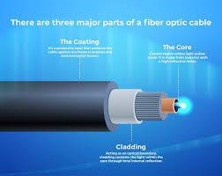
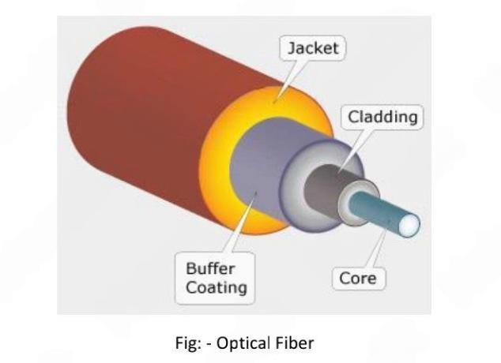
iii) Optical Fiber
It is made up of a glass or plastic that transfer signals in form of light. The main core glass is surrounded by a strong cladding with lower index of refraction. It works on the principle of total internal reflection.

Slide 31
Advantages of Optical Fiber
The speed of optical fiber is highest of all cables i.e. Gbps, Tbps and even more.
This medium can be used for long distance transmission.
It is not affected by electromagnetic interference.
It is the most secured, as it is difficult to tap the data because data is
transmitted in the form of light.
Disadvantages of Optical Fiber
It is one of the expensive type of transmission media.
It is not used for short distance transmission.
Highly qualified and technical manpower are required to operate on fibre optics.
It is very difficult to connect any two optical fibers and bend them.

Slide 32

Unguided media/Wireless/Unbounded Media
Unguided media is also called wireless media in which there is no physical connection between any two communicating devices i.e. it transmits signals via air. For example, infrared, Bluetooth, Wi-Fi, microwaves (radio waves), satellite, etc.
i. Infrared: Infrared has the shortest transmission distance that follows the line of sight. It can support distance up to 10m and supports very low bandwidth.

Slide 33
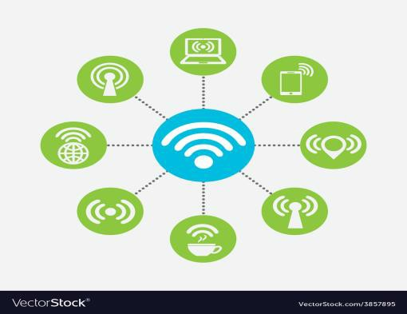
ii. Bluetooth: Bluetooth is a short-range wireless technology that is used for exchanging data between fixed and mobile devices over short distance (up to 10m to 20m). It relies on and does not require line of sight that is it can pass through obstacles. For example, speaker, headset, mobile phones, etc.
iii) Wi-Fi: Wi-Fi is a wireless networking technology that uses radio waves to provide wireless high-speed internet access. It uses high band frequencies such as 2.4 GHz up to 5 GHz. For example, IoT devices.

Slide 34
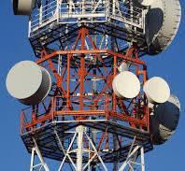
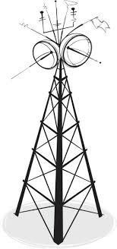
iv) Microwave: Microwave
is a modern technology that uses
electromagnetic waves with microwave frequency ranges 300 MHz to 300 GHz.
from
For example, FM stations, telecommunication towers , etc .

Slide 35
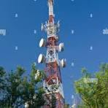

V) Radio wave: It is the type of wireless transmission medium that can operate on single as well as multiple frequency band. In this type of transmission medium sender and receiver station must not be in the line of sight.

Slide 36
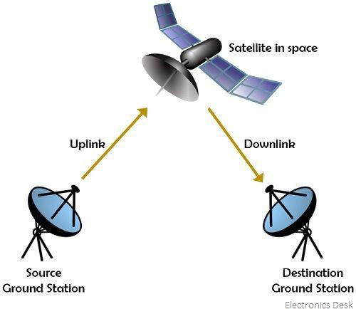
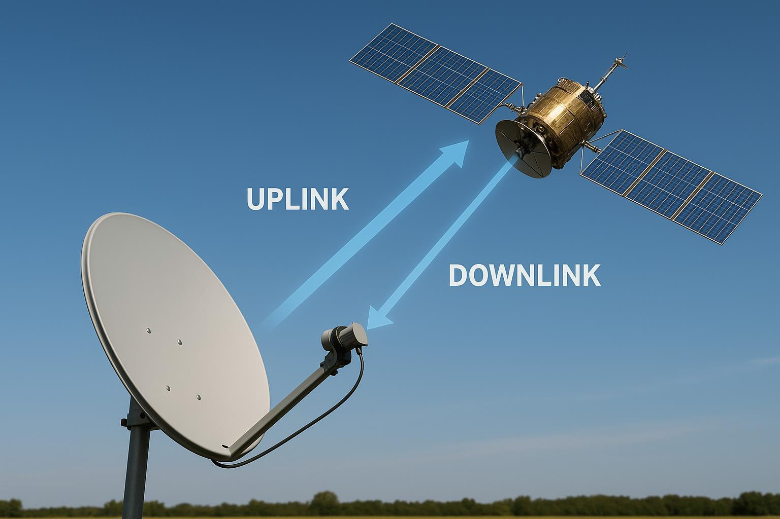
VI) Satellites: Satellites are kept at around 36000 km above the earth surface which continuously rotates in the same orbit. The communication is done through uplink and downlink using ground
stations. It is used for universe study, GPS, military Majorly Satellites are of two types :
i) Geo Stationary Satellite and
purpose, etc.
ii) Space Satellite:
Space Satellite
dishHome
Ground Station
Fig: Satellite

Slide 37
Receiver: Receiver, in electronics, any of various devices that accept signals, such as radio waves, and convert them (frequently with amplification) into a useful form. Examples are telephone receivers, which transform electrical impulses into audio signals, and radio or television receivers, which accept electromagnetic waves and convert them into sound or television pictures

Slide 38
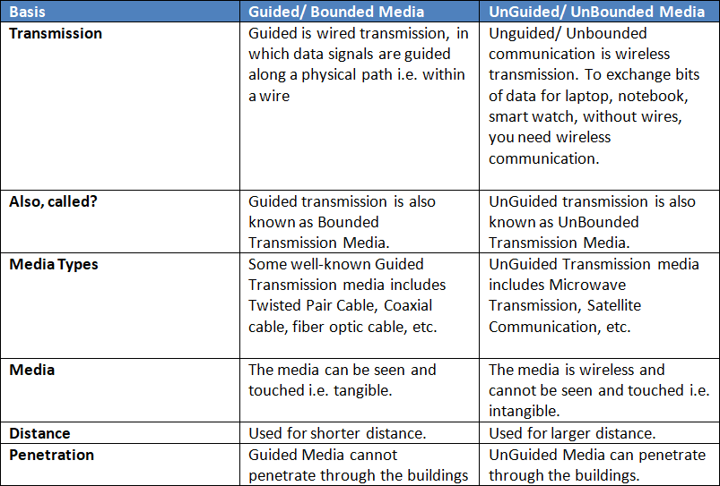
Difference between Guided and Unguided media

Slide 39
Transmission Impairments Terminology
Transmission impairments occur when the received signal is different from the transmitted signal.
Some if the impairments are given below:
Jitter: Jitter is a fluctuation in delay as packets are being transferred across a network. It is also called variation in time between data packets that may be caused by transit points or network traffic.
Echo: Echo is a sound that is a copy of another sound is produced when sound waves bounce on the surface.
Crosstalk:
Cross is a form of interference in which signal in one cable is mixed with another cable.

Slide 40
Distortion:
Distortion is a change in the form or shape of a signal that can cause an unclear reception.
Noise:
Noise is the mix-up of different unwanted signals or frequencies while communicating the messages from one end to another.
Bandwidth:
Bandwidth refers to the speed of the internet i.e. it justifies the number of bits (mb, kb) that can be communicated by a sender to receiver in one second.

Slide 41
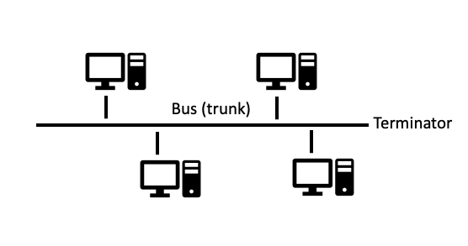
Network Topology / LAN Topology
Network Topology
Network topology is the way of arrangement of computers in a network.
1 ) Bus Topology: - Bus topology is a type of network topology in which all the computers or digital devices are connected. There are termination points on the both sides t o protect the data signal
loss.

Slide 42
Advantages
It is easy setup.
It is not expensive as it requires least amount of cable.
It is easy to implement and extent.
Terminator doesn't allow data to escape
Each computer in a network has equal access and priority to communicate on the network.
Disadvantages:
Since every computer in a network are connected to the bus, if the cable fails to work then whole network is affected.
As the number of computer increases, performance decreases.
It cannot cover large geographical area.

Slide 43
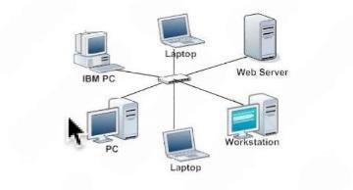
2 ) Star Topology: - Star topology works a s a client-server network architecture in which there is a main central node and all other nodes are connected to the central one.

Slide 44
Advantages
Adding and removing computers and devices is very easy.
If one computer fails to works its doesn’t affect the entire
network.
It is one of the most reliable and practical network topology.
Disadvantage
It depends upon a central device so if it fails to work it affect the whole network.
It maybe expensive as we require maximum number of cables and devices.

Slide 45
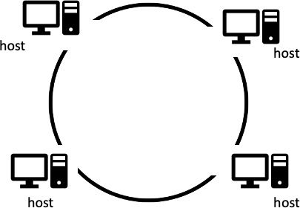
3 ) Ring Topology: - Ring topology is a type of topology which is in ring shape and each node is connected t o one another without any centralized control.

Slide 46
Advantages
All station (nodes) have equal access.
As data travels in only one direction, speed is high.
Since each computer act as a repeater it can be extended to a greater distance.
Increase in number of computer will have minimal impact to overall network performance.
Disadvantages
Since every computer are connected with the single cable, if that single cable fails to work whole network is affected.
Adding computer in this type of network is difficult as we need to rewrite the program.

Slide 47
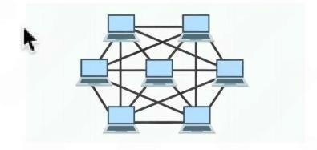
4 ) Mesh Topology
In this topology, all the computers are connected with each other via multiple channels i.e. all the computers a r e connected with direct communication link.

Slide 48
Advantages
Data transmission is faster in this type of topology.
Since devices are connected point to point , it is one of the reliable network topology.
Identifying faults and isolating them is easier.
Disadvantages
It is expensive as it use maximum number of cables.
This type of network topology is difficult and complex in structure.

Slide 49
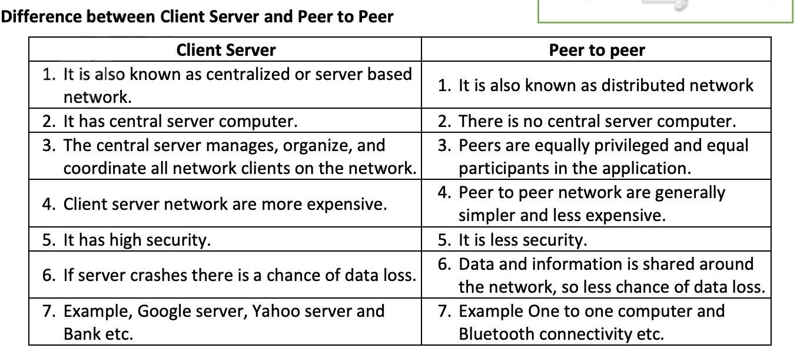

Slide 50
OSI Reference Model
OSI (Open System Interconnection) reference model It is based on a proposal developed by the international organization for standardization (ISO). The model is called ISO OSI reference model, because it deals with connecting open system i.e. the system that are open for communication with other system.

Slide 51
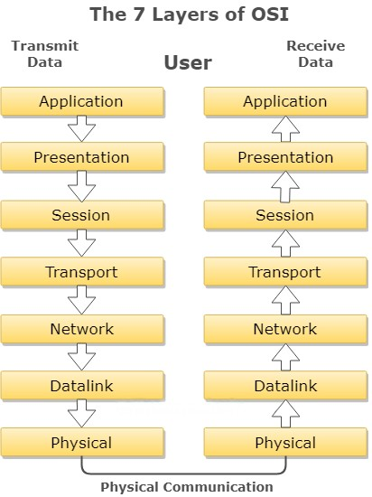
7
6
5
4
3
2
1

Slide 52
Physical Layer: This layer concerned with transmission of bit it determines voltage level for 0 & 1. It also determines the data rate of the system. This layer involves standardized protocol dealing with electrical & signaling interface.
Data Link Layer: It handles error in physical layer. This layer ensures the correct delivery of frame to the destination address. It consists of 2 parts or 2 sub-layers. i.e.
Logic Link Control
Media Access Control

Slide 53
Network Layer: This layer is concerned with transmission of packet. N/w layer protocol chooses the best path to send a package called routing. Two protocols are widely used in n/w layer.
X.25 Protocol
Internet Protocol
Transport Layer: It provides the mechanism for the exchange of data between end systems. It ensures that the data received is in fact in order. Following jobs are performed by this layer.
Port Addressing
Segmentation & Reassemble
Connection Control

Slide 54
Session Layer: It is responsible for requesting logical connection to be established for communication process. This logical connection is termed as session. It also provides data synchronization between two communication terminals.
Presentation layer: This layer translates format data to adapt to the needs of the application layer & nodes at both receiving & sending end of communication process. It handles data communication, formatting, encryption, decryption, etc.
Application Layer: It is the top-most layer of OSI model & provides user access to the n/w. It provides services that support user application, such as database access, email & file transfer, etc.

Slide 55
1. Network Connecting devices: The devices of computer network which are used to connect network is called the network connecting devices. We can connect two or more networks together to create larger network. A LANs can be connected others LANs, MANs or WAN.

Slide 56
Repeaters: As the name implies, repeaters repeat network data. In general, repeaters operate at the electronic level and contain no real intelligence. A repeater accepts weak signals, electrically regenerates them and then sends the messages on their way. There are two types of repeaters: amplifiers and signal-regenerating repeaters.

Slide 57
3. Hubs: Technically speaking, a hub is simply a multi-port repeater. In addition to regenerating network data, hubs add form and function to the layout of the LAN. In many topologies, the hub is the central component of the network transmission media. There are three types of hubs. They are the passive hub, active hub and intelligent hub.

Slide 58
4. Bridge:
It is a device, which connects different network segments
and passes data with the same communication protocols. It is the connecting device between two or more hubs. - It operates at layer 2 (Data Link Layer) of OSI Model. - It reduces unnecessary traffic problem by controlling broadcasting. - Bridges are more intelligent than hubs because they maintain MAC address tables in them and forward data looking on it.

Slide 59
5. A router transmits information from one network to
Router:
another. The router selects the best path to route a message, based on the destination address and origin. The router can direct traffic to prevent head-on collisions and smart enough to know when to direct traffic along back roads and shortcuts. - Direct signal traffic efficiently. - Route message between any two protocols. - Route message between different topologies. - Route message across fiber optic, coaxial, and twisted-pair cabling.

Slide 60
6. Gateways are just like routers but much more
Gateways:
complex and powerful than routers. They are slower than router and expensive. A gateway has all the features of router and bridges but it can translate instruction set on sending network into receiving network. - Gateways make communication possible between different architecture and environments. - Gateways having higher layer functionalities and works on multiple layer protocols.

Slide 61
7. Wi-Fi (Wireless Fidelity):- The term Wi-Fi suggests wireless Fidelity. It is hardware and software devices. It is wireless technology and network connecting device. Wi-Fi is not a technical term. The technical term of Wi-Fi is "IEEE802.11" - It has limited range. - Wi-Fi is used in many personal computers, video game consoles, MP3 players, smart phones, printers, digital camera, laptops computers and other devices. - Wi-Fi is used to create wireless LAN to connect computer system.

Slide 62
8. Bluetooth: Bluetooth is a wireless technology standard for exchange data over short distance from fixed and mobile devices. Bluetooth is used to create personal area networks (PANs) with high levels of security.

Slide 63
9. Infared (IR) light is electromagnetic radiation with a
Infared (IR):
wavelength longer than that of visible light and below the red light. These wavelengths correspond to a frequency range of approximately 100 GHz to 100 THz and include most of the thermal radiation emitted by objects near room.

Slide 64
Some basic terms Internet The Internet is an interconnected network of thousands of networks and millions of computers linking business, education institutions, government agencies, and individuals together. Used / application of internet
Search information
E-mail service
Communication
File Transfer
5. eg> any desk,team viwer ,google meet
Remote login /
Publishing of articles, reports, and newsletter.
Online education
Online shopping.
9. Entertainment.

Slide 65
IP ADDRESS
An IP address is a unique numerical label assigned to each device connected
to a computer network that uses the Internet Protocol for communication. A
subnet, or subnetwork, is a logical subdivision of an IP network. Subnetting
allows administrators to divide a larger network into smaller, more manageable
segments, improving network organization and efficiency. IP Addresses:
Purpose:
IP addresses serve as identifiers for devices on a network, enabling them to send and receive data.
Format:
IP addresses are typically represented in dotted decimal notation (e.g.,
192.168.1.1).
Types:
There are two main versions of IP addresses: IPv4 (32-bit) and IPv6 (128-bit).

Slide 66
Private IPv4 Ranges:
1. 10.0.0.0 to 10.255.255.255: This is a Class A network, offering a large number of addresses.
2. 172.16.0.0 to 172.31.255.255: This is a Class B network, providing a moderate number of addresses.
3. 192.168.0.0 to 192.168.255.255: This is a Class C network, offering a smaller number of addresses.
These ranges are defined in RFC 1918 and are not publicly routable. They are used within private networks, such as home networks or corporate networks, to assign addresses to devices that do not need direct access to the internet.

Slide 67
Public IPv4 Addresses:
All other IPv4 addresses that do not fall within the private ranges mentioned above are considered public.
These addresses are globally unique and assigned by Regional Internet Registries (RIRs) to organizations and individuals for internet connectivity.
Public IPs are necessary for devices to communicate directly with other devices on the internet.

Slide 68
Subnet Masks:
Subnet masks are used to determine which part of an IP address identifies the network and which part identifies the host within that network.
Example:
Imagine a large company with separate departments (engineering, sales, etc.). Subnetting could allow each department to have its own subnet, making it easier to manage network access and traffic flow for each department.

Slide 69
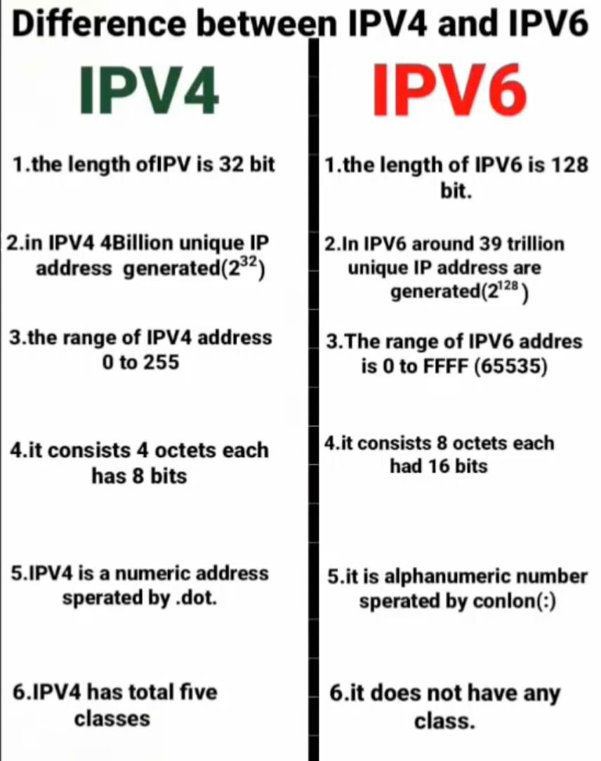

Slide 70
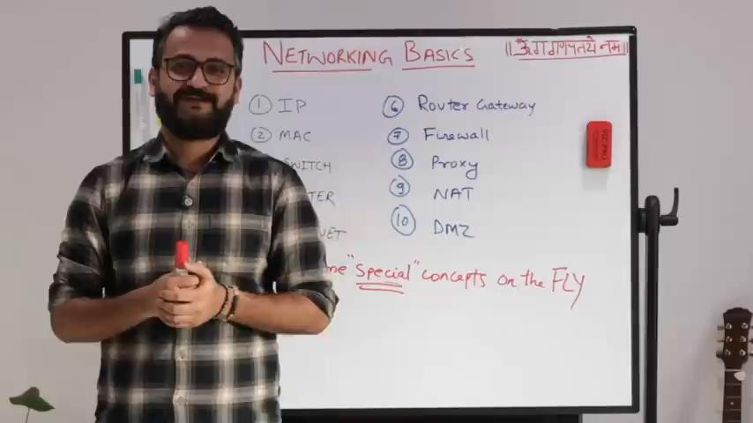
Visit following Youtube video link to know furthermore about networking terms like IP Mac Subnet Switch Router
DHCP DNS Gateway
https://youtu.be/z_CU-IeOEzU?si=GVVYsolPq3RbePQu
OR PLAY

Slide 71

https://youtu.be/5WfiTHiU4x8?si=AvdOQjYXJdyL_2Y7
OR play
Further more visit

Slide 72
MAKE NOTE BY YOURSELF
IP ADDRESS
IPV4 and IPV6
Public IPV4 vs Private IPV4
SUBNET MASK
SUBNET CLASS

Slide 73
Internet Protocols
Protocols are the set of rules that controls and coordinates the transmission of message over the network, which are responsible for successful communication between different networking devices.
Types of protocols
Some standard protocols are explained below:
1. TCP, transmission control protocol, is responsible for
TCP: -
dividing the data packets into smaller pieces which can be then transferred from one location to another using IP.
2.
IP: -
IP, Internet Protocol, is responsible for providing the route to
the data while transferring through different medium or channels.

Slide 74
3)
FTP:
- FTP, File Transfer Protocol, is responsible for transferring
the files (uploading or downloading) over t h e network.
4) SMTP stands for Simple Mail Transfer Protocols
SMTP and POP: -
whereas POP stands for Post Office Protocols. These protocols are used to transmit the data from one mail server to another mail serv er.
5) HTTP, Hypertext Transfer Protocol, is responsible for
HTTP : -
displaying the web contents (text, images, audio, video, even programming etc.). These days HTTPS is in trend because it is more
secure than HTTP and uses encryption and decryption technology.

Slide 75
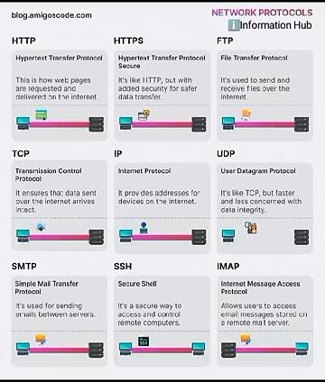
Watch for more info about diff protocols
https://www.youtube.com/shorts/eF8C1uyeknA

Slide 76
Assignments
IMPORTANT QUESTIONS
1. What is Computer Network? List its Advantages and Disadvantages. [1+2+2] vimp
Ans keys : definition of computer network+ advantages and disadvantages at least 2-2 point
2) Define Communication System? Mention elements of data
communication with block diagram. [1+4]
Ans key: definition+ figure+ explain any four elements. Look at 3)What is Transmission Media? Explain its types. [2+6] vimp
slide no: 2,3,4
Ans key: definition and types+ explain all guided and unguided media + definition +fig with at least 2-2 advantages and disadvantages
What is communication Mode? Describe its types with example.[1+4] imp
Ans key : definition+ explain all modes with suitable figure slide no: 7 ,8,9
Differentiate between LAN, WAN, and MAN. [5]
Ans key: at least five point in table.
Look at slide no: 18

Slide 77
6) Differentiate between Internet, Extranet, and Intranet. [5]
Ans key at least five point in table
Look at slide no: 19
Define Network Architecture. Explain Its types. [1+4] VIMP
Ans: definition of Peer to Peer and along with figure with at least 2-2 advantages and disadvantages
Ans: definition of client server network architecture and along with figure with at least 2-2 advantages and disadvantages
What are network topologies? Describe its types. [2+6] VIMP
Defination of network topology and list types only. [2]
Defination of Bus topology +figure+ advantages and disadvantages at least 2-2 point. [2]
Defination of Star topology +figure+ advantages and disadvantages at least 2-2 point. [2]
Defination of Ring topology +figure+ advantages and disadvantages at least 2-2 point. [2]

Slide 78
9) Difference between Guided and Un-Guided transmission media.
Ans key: at least five point in table.
Look at slide no: 38
Define OSI reference model. Explain its Layers.[2+6] vimp Ans key: Defination of OSI +figure+ Explain all 7 layers.
What is Internet Protocol? Mention its types. [1+4]
Ans key: Defination of Internet Protocol+ Explian all types.
Differentiate between Client Server and Peer to Peer network architecture? [5]
Ans key: at least five point in table.
Visit slide no: 71, 72 and 75 for furthermore info about basic terms.
THE END

Slide 79
Revision for second term 2082
Long question
What are network topologies? Describe its types with their advantages and disadvantages along with their diagram. [2+6]
Define OSI reference model. Explain its Layers.[2+6] Note: you also need to draw different diagram.
3.
Short Question
What is communication Mode? Describe its types with example.[1+4] Note: you also need to draw different diagram.
Differentiate between Client Server Network Architecture and Peer to Peer network architecture? [5]
Define Network Architecture. Explain Its types. [1+4]

